Slide 1
Management of chronic heart failure
Dr.Suresh.S
SR Cardiology
Calicut medical college

Slide 2
Aetiology of HF
VALVULAR HEART DISEASE
Mitral
Aortic
Trisuspid
Pulmonary
MYOCARDIAL DISEASE
Coronary artery disease
Hypertension
Cardiomyopathy
ENDOCARDIAL DISEASE
With/without hypereosinophilia
Endocardial fibroelastosis
PERICARDIAL DISEASE
Constrictive pericarditis
Pericardial effusion
HEART
FAILURE
ARRHYTHMIA
Tachyarrhythmia
Atrial
Ventricular
Bradyarrhythmia
Sinus node dysfunction
CONDUCTION DISORDERS
Atrioventricular block
HIGH OUTPUT STATES
Anaemia
Sepsis
Thyrotoxicosis
Paget‘s disease
Arteriovenous fistula
VOLUME OVERLOAD
Renal failure
Iatrogenic (e.g. post-operative fluid infusion
CONGENITAL
HEART DISEASE

Slide 3
Pathophysiology of HF
Injury to myocytes due to myocardial infarction or other cause
VENTRICULAR
REMODELING
ELECTRICAL INSTABILITY
REDUCTION of EF
NEUROHUMORAL IMBALANCE
An imbalance occurs in three key neurohumoral systems:
The renin–angiotensin–aldosterone system
The sympathetic nervous system
The natriuretic peptide system

Slide 4
Objectives of treatment for chronic HF
1. Prognosis | reduce mortality
2. Morbidity | relieve symptoms and signs improve QoL eliminate edema and fluid retention increase exercise capacity reduce fatigue and breathlessness reduce the need for hospitalization provide end of life care
3. Prevention | occurrence of myocardial damage progression of myocardial damage remodelling of the myocardium reoccurrence of symptoms and fluid accumulation hospitalization

Slide 5
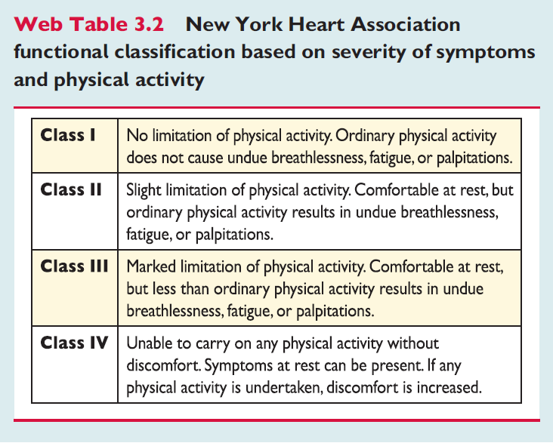

Slide 6
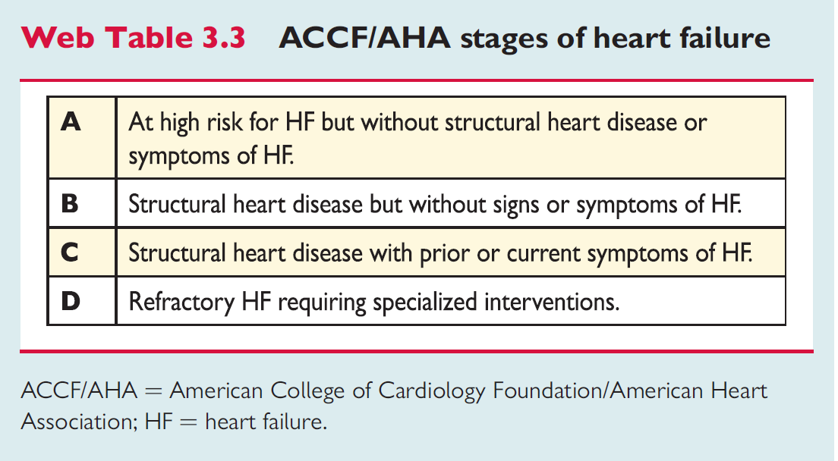

Slide 7
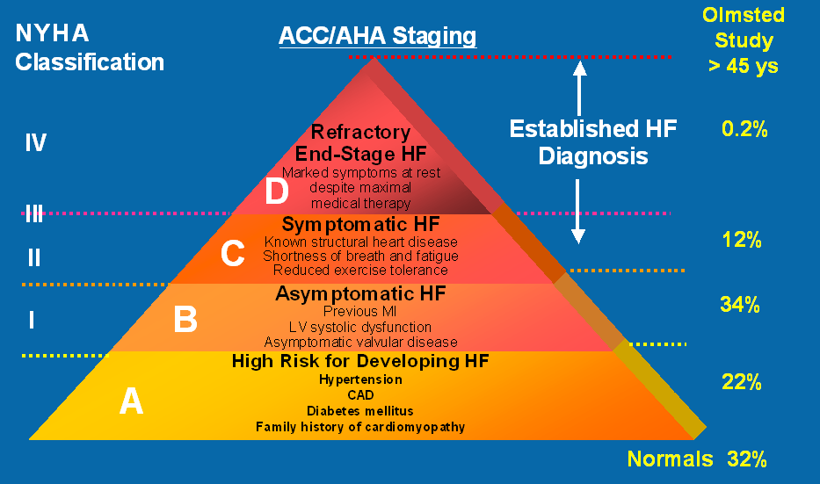

Slide 8
Stages, Phenotypes and Treatment of HF

Slide 9
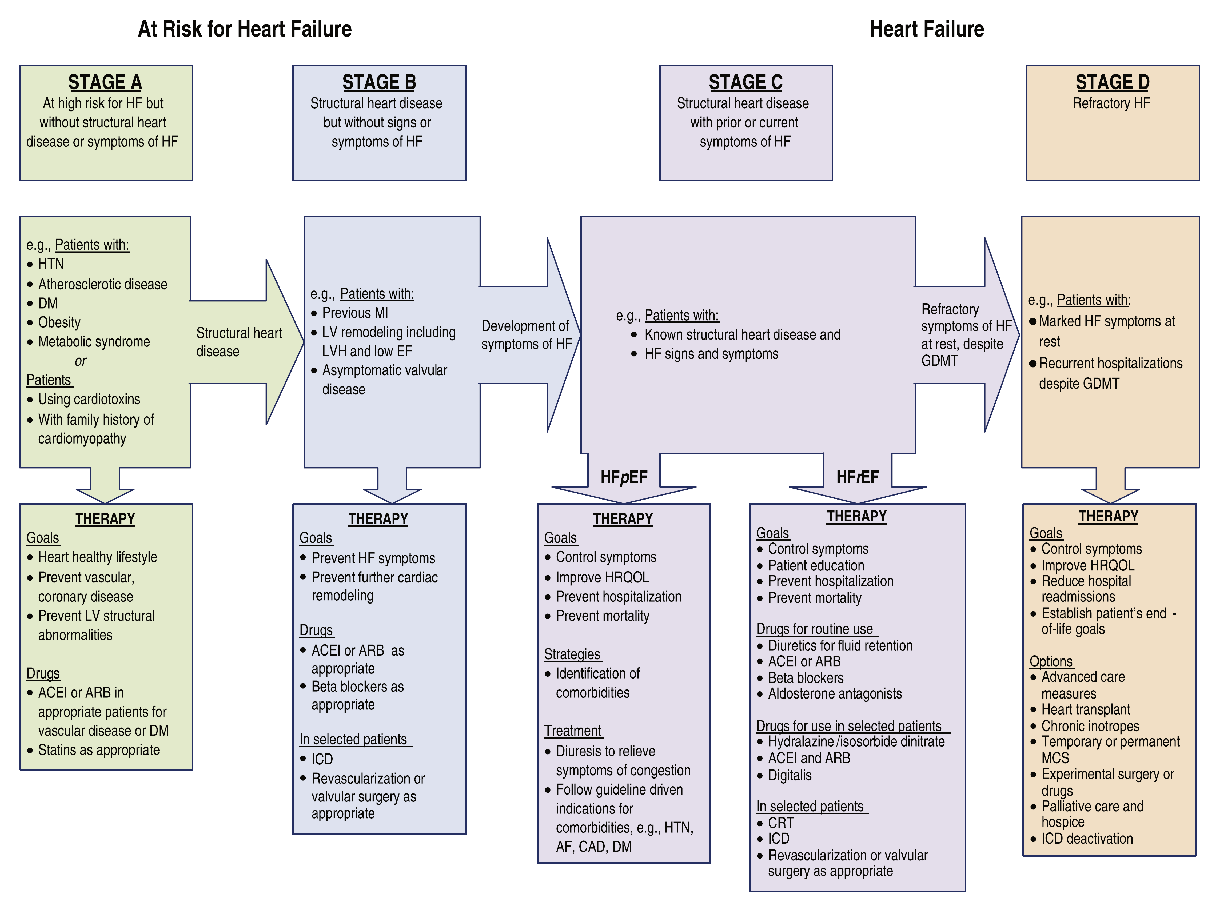

Slide 10
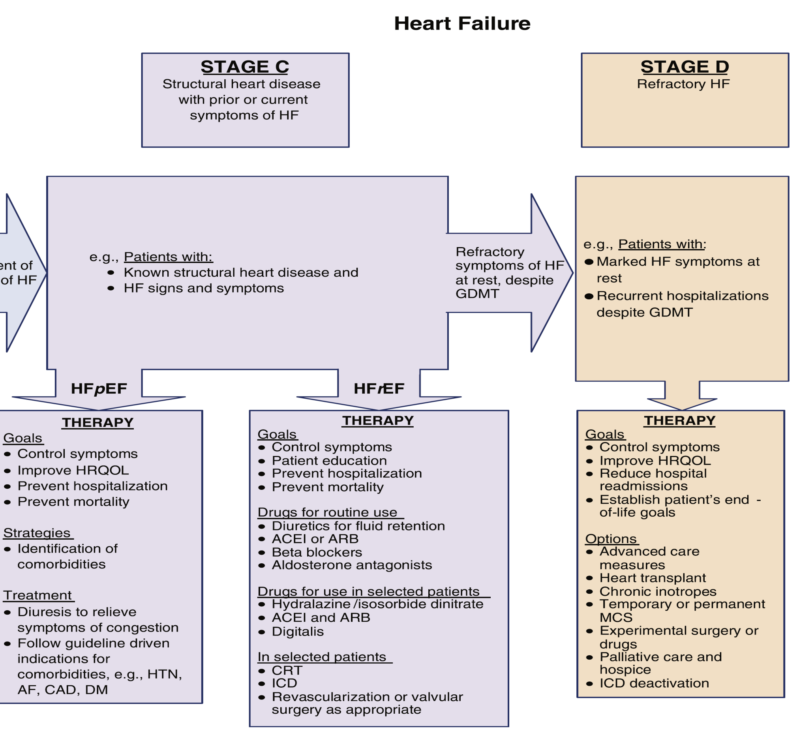

Slide 11
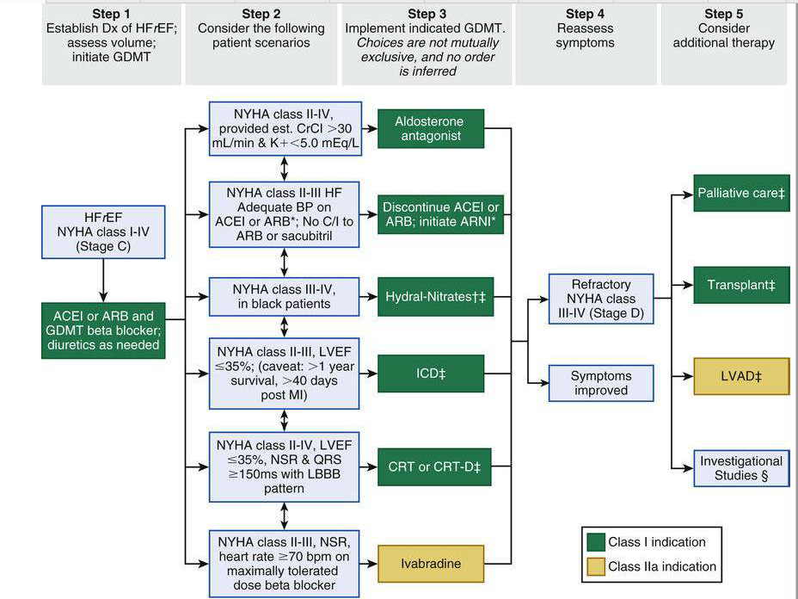

Slide 12
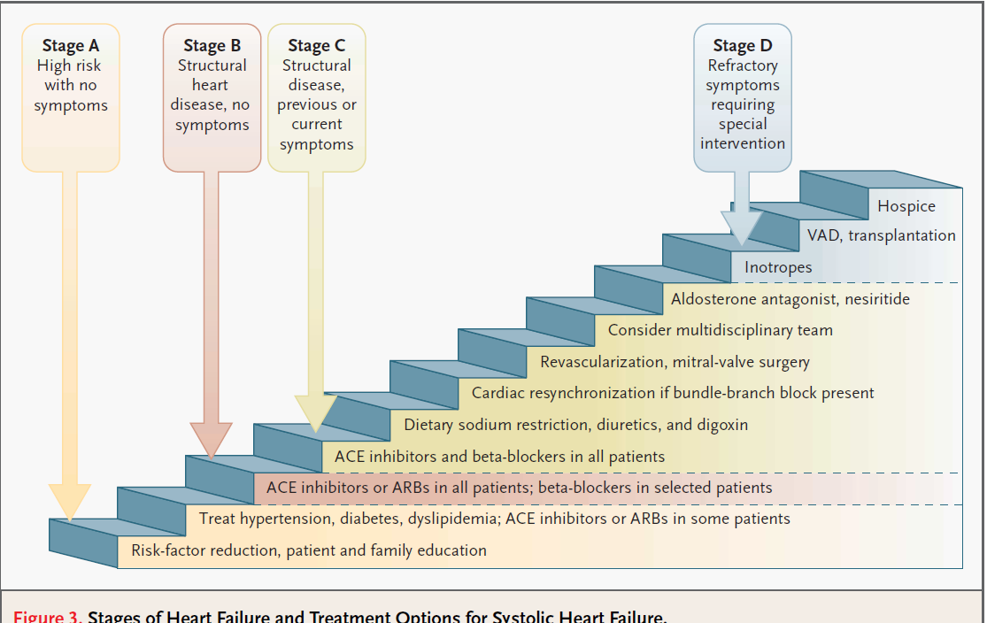

Slide 13
General therapeutic approach to chronic heart failure
Determine the etiology
Look for precipitating factors
Nonpharmacological treatment
  sodium restriction<2g
  Aerobic exercise
  Wt loss in obese patient
Treat HTN and other comorbidity
Pharmacological treatment
  ACE-I
  ARB
  MRA
  Beta blockers
  Vasodilators
  Diuretics
  digoxine
Device theraphy
  CRT
  ICD
  LVAD

Slide 14
Pharmacological treatment
TREATMENT RECOMMENDED in all symptomatic HFrEF
  ACE-I
  BB
  MRA
OTHER tx recommended in selected symptomatic pt
  Diuretics
  ARB
  If channel inhibitor
  ARNI
  Comb of hydralazine and isosorbide dinitrate
Other tx with less certain benefits in sympt pt
  Digoxin
  N-3 PUFA
Tx with unproven benefit
  HMG CoA reductase inhibitors
  OAC and antiplatelets
  Renin inhibitors
Tx not recommended
  Calcium channel blockers

Slide 15
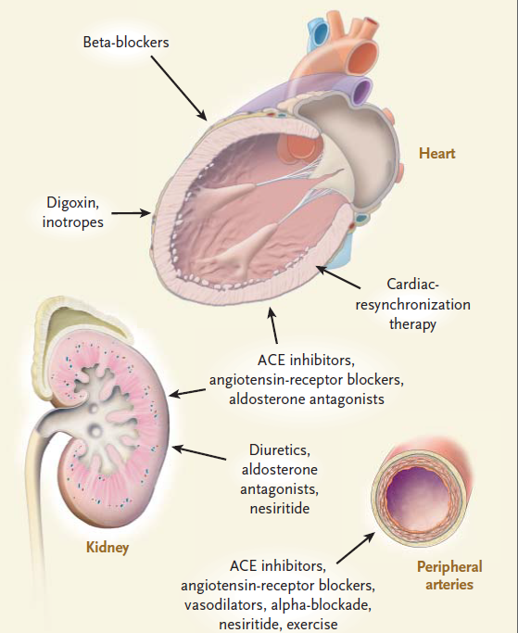

Slide 16
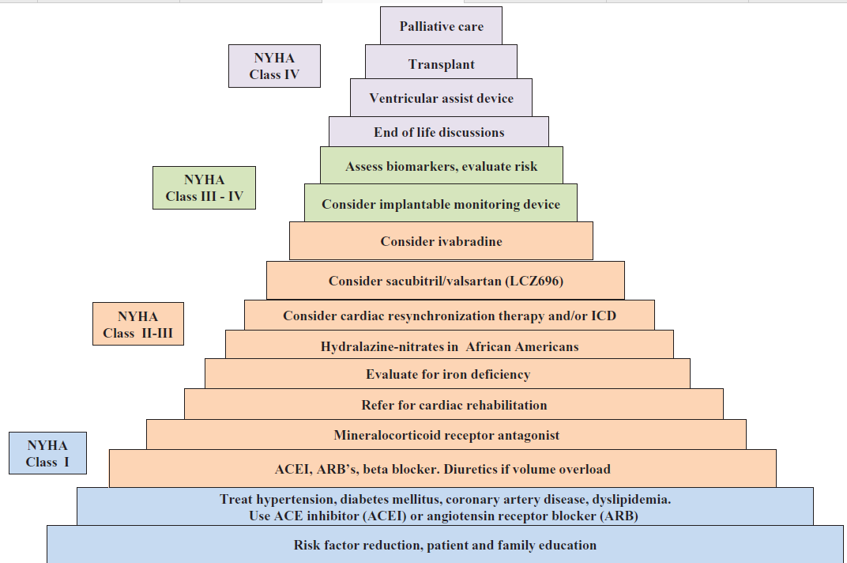

Slide 17
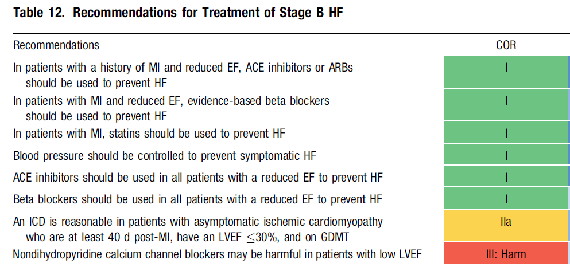

Slide 18
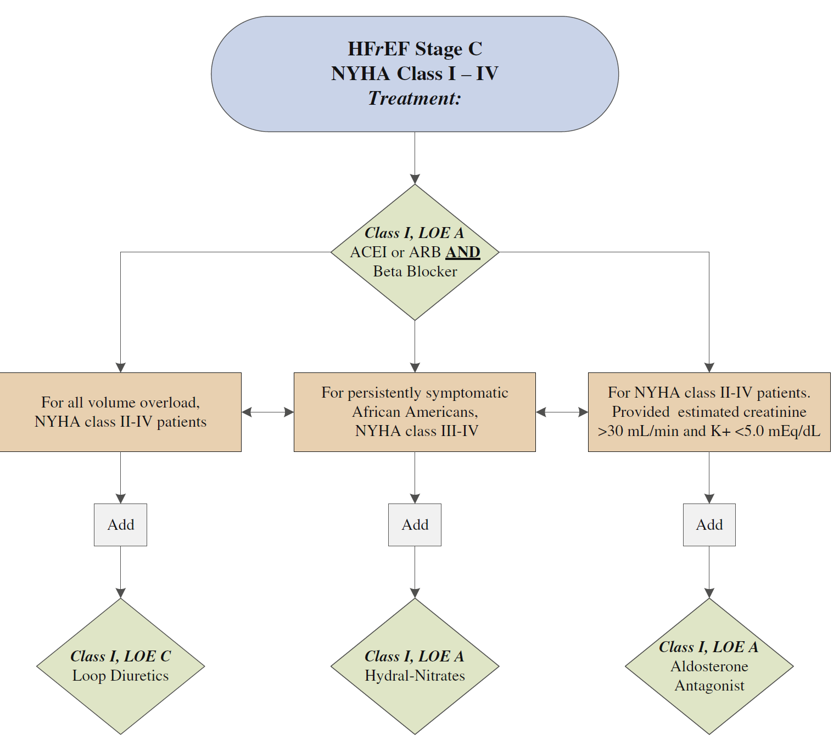

Slide 19
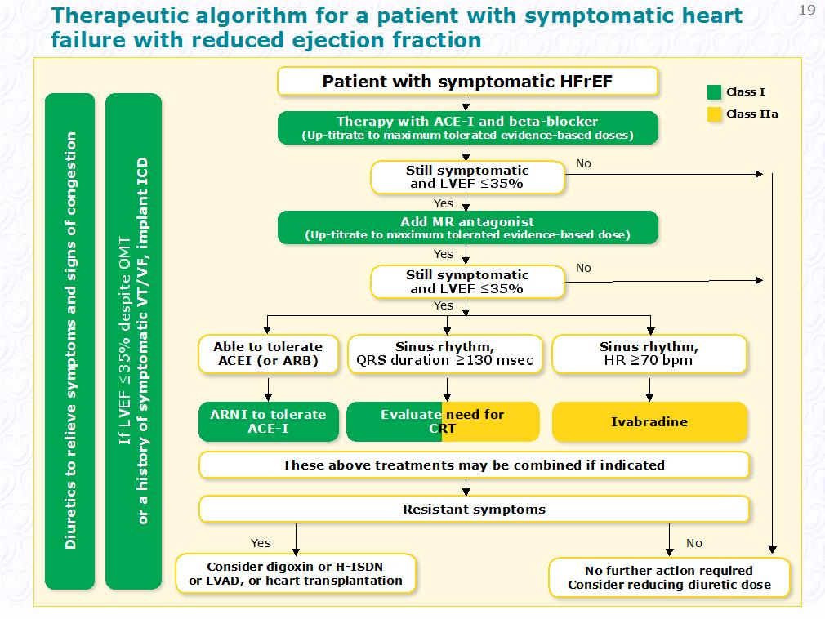

Slide 20
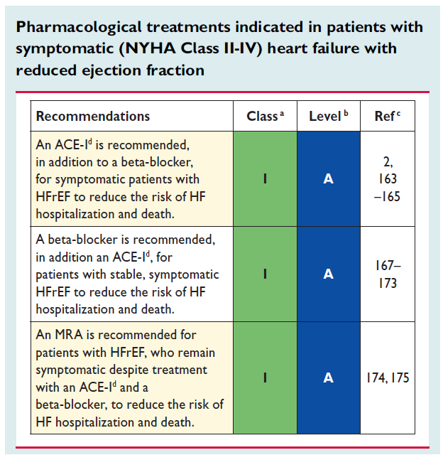

Slide 21
Pharmacological Therapy for Management of Stage C HFrEF
Recommendations | COR | LOE
Diuretics
Diuretics are recommended in patients with HFrEF with fluid retention | I | C
ACE Inhibitors
ACE inhibitors are recommended for all patients with HFrEF | I | A
ARBs
ARBs are recommended in patients with HFrEF who are ACE inhibitor intolerant | I | A
ARBs are reasonable as alternatives to ACE inhibitor as first line therapy in HFrEF | IIa | A
The addition of an ARB may be considered in persistently symptomatic patients with HFrEF on GDMT | IIb | A
Routine combined use of an ACE inhibitor, ARB, and aldosterone antagonist is potentially harmful | III: Harm | C

Slide 22
Pharmacological Therapy for Management of Stage C HFrEF
Recommendations | COR | LOE
Beta Blockers
Use of 1 of the 3 beta blockers proven to reduce mortality is recommended for all stable patients | I | A
Aldosterone Antagonists
Aldosterone receptor antagonists are recommended in patients with NYHA class II-IV HF who have LVEF ≤35% | I | A
Aldosterone receptor antagonists are recommended in patients following an acute MI who have LVEF ≤40% with symptoms of HF or DM | I | B
Inappropriate use of aldosterone receptor antagonists may be harmful | III: Harm | B
Hydralazine and Isosorbide Dinitrate
The combination of hydralazine and isosorbide dinitrate is recommended for African-Americans, with NYHA class III–IV HFrEF on GDMT | I | A
A combination of hydralazine and isosorbide dinitrate can be useful in patients with HFrEF who cannot be given ACE inhibitors or ARBs | IIa | B

Slide 23
Pharmacologic Therapy for Management of Stage C HFrEF
Recommendations | COR | LOE
Digoxin
Digoxin can be beneficial in patients with HFrEF | IIa | B
Anticoagulation
Patients with chronic HF with permanent/persistent/paroxysmal AF and an additional risk factor for cardioembolic stroke should receive chronic anticoagulant therapy* | I | A
The selection of an anticoagulant agent should be individualized | I | C
Chronic anticoagulation is reasonable for patients with chronic HF who have permanent/persistent/paroxysmal AF but without an additional risk factor for cardioembolic stroke* | IIa | B
Anticoagulation is not recommended in patients with chronic HFrEF without AF, prior thromboembolic event, or a cardioembolic source | III: No Benefit | B
Statins
Statins are not beneficial as adjunctive therapy when prescribed solely for HF | III: No Benefit | A
Omega-3 Fatty Acids
Omega-3 PUFA supplementation is reasonable to use as adjunctive therapy in HFrEF or HFpEF patients | IIa | B

Slide 24
Pharmacological Therapy for Management of Stage C HFrEF
Recommendations | COR | LOE
Other Drugs
Nutritional supplements as treatment for HF are not recommended in HFrEF | III: No Benefit | B
Hormonal therapies other than to replete deficiencies are not recommended in HFrEF | III: No Benefit | C
Drugs known to adversely affect the clinical status of patients with HFrEF are potentially harmful and should be avoided or withdrawn | III: Harm | B
Long-term use of an infusion of a positive inotropic drug is not recommended and may be harmful except as palliation | III: Harm | C
Calcium Channel Blockers
Calcium channel blocking drugs are not recommended as routine in HFrEF | III: No Benefit | A

Slide 25
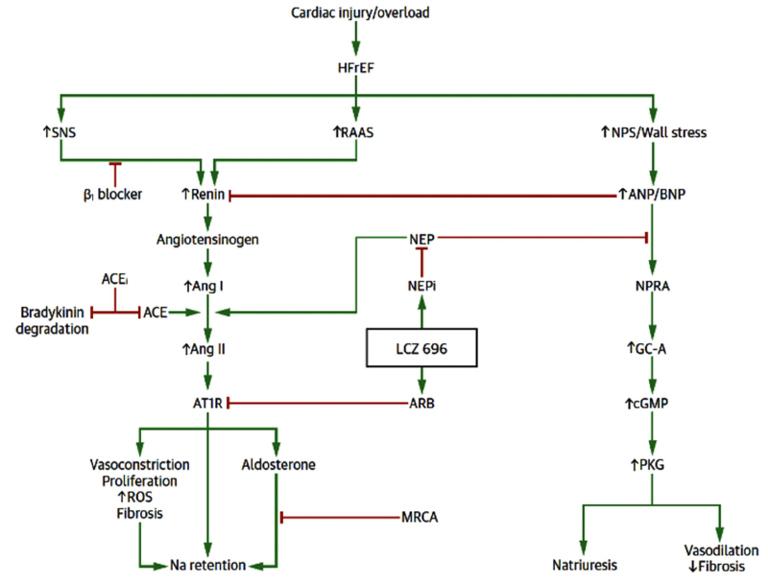

Slide 26
ACE-I/ARB
WHY?
Indications:
To improve symptoms and exercise capacity
reduce the risk of HF hospitalization
increase survival.
all patients with HF and an LVEF <40%.
First-line treatment (along with BB and MRA) in HF NYHA Class II–IV
start as early as possible in the course of disease.
Also benefit in asymptomatic NYHA I
Contra-indications
1. History of angioedema
2. Known bilateral renal artery stenosis
3. Pregnancy/risk of pregnancy.

Slide 27
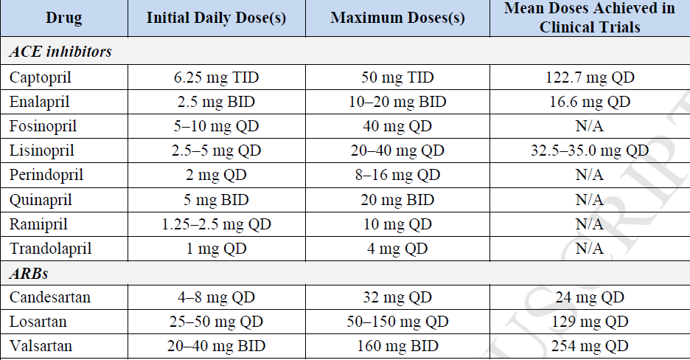
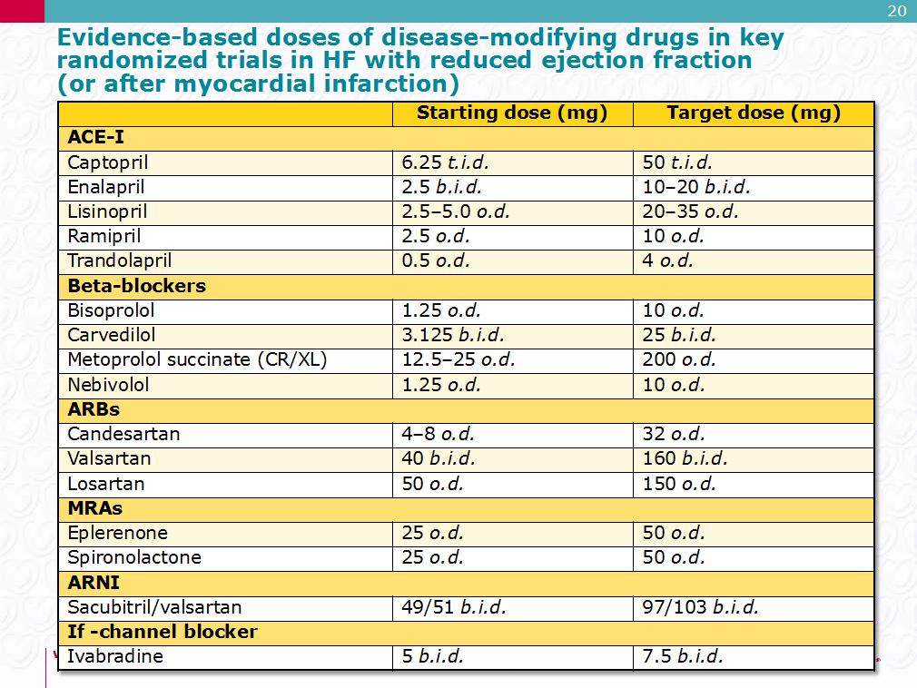
ACC
ESC

Slide 28
Cautions
HOW TO USE?
1.K+ >5
2. Cr>2.5/GFR<30
3. systolic blood pressure <90 mmHg).
4. Drug interactions
K+ supplements
K+-sparing diuretics
MRAs.
Renin inhibitors
NSAIDsd.
Trimethoprim/trimethoprim-sulfamethoxazole.
Low-salt’ substitutes with a high K+ content.
Check RFT and S/E
Start with low dose
Double not less than 2wk
Aim for target dose
Recheck RFT after 1-2 wk of initiation
Monitor RFT every 4 months

Slide 29
Cough
Worsening renal function and hyperkalaemia
smoking-related lung disease
pulmonary oedema.
ACE-I-induced cough does not always require treatment discontinuation.
When a troublesome cough does develop (e.g. one stopping the patient from sleeping) and can be proved to be due to ACE-inhibition (i.e. recurs after ACE-I withdrawal and re-challenge),
substitution of an ARB is recommended
Some rise in RFT &K is to be expected after an ACE-I; if an increase is small and asymptomatic, no action is necessary..
An increase in potassium to ≤5.5 mmol/L or Cr 3 is acceptable.
If potassium rises to >5.5 mmol/L or creatinine increases by >100% or to >3.5 mg/dL/eGFR <20 mL/min/1.73 m2, the ACE-I (or ARB) should be stopped

Slide 30


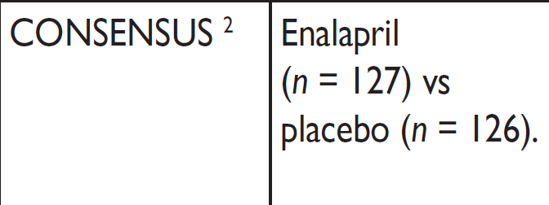
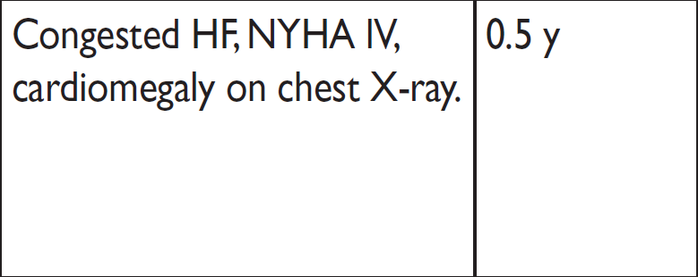

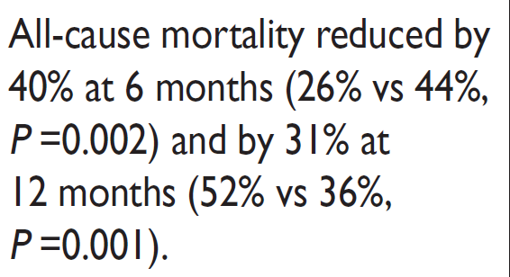

Slide 31
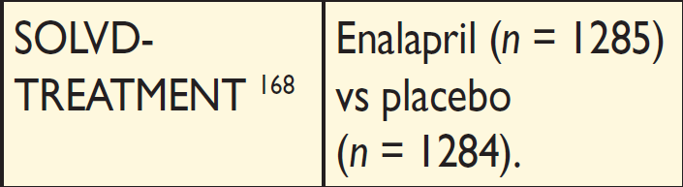
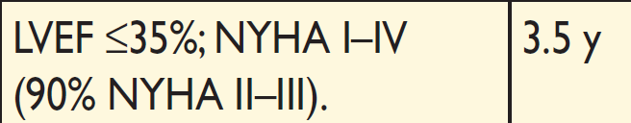
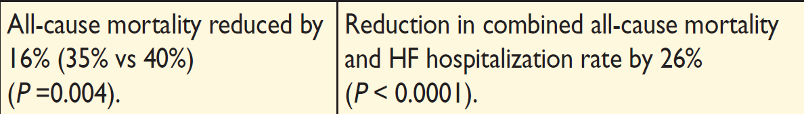

Slide 32
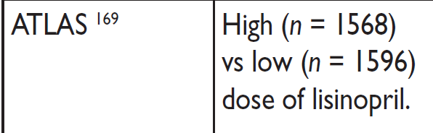
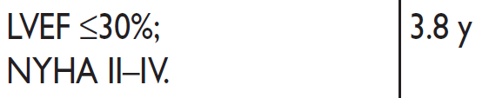
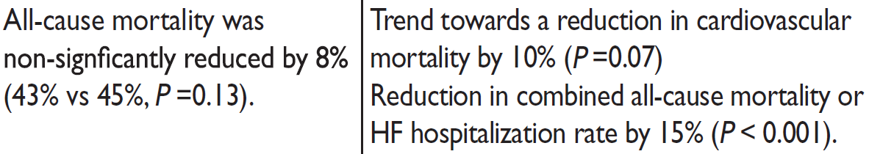

Slide 33
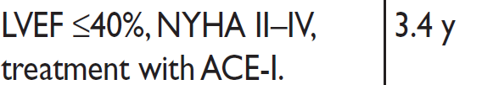
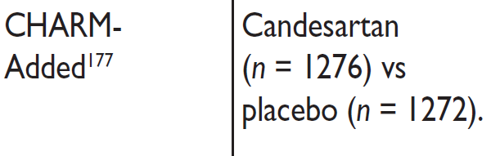
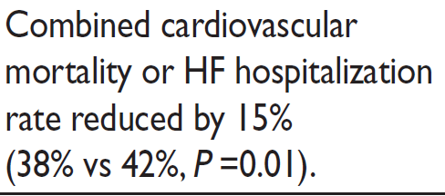

Slide 34
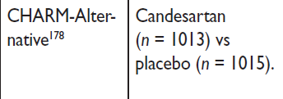
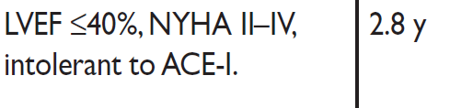
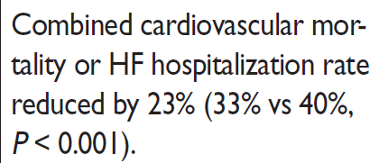

Slide 35
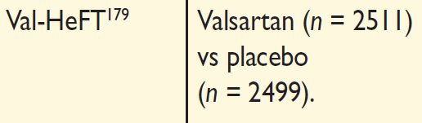
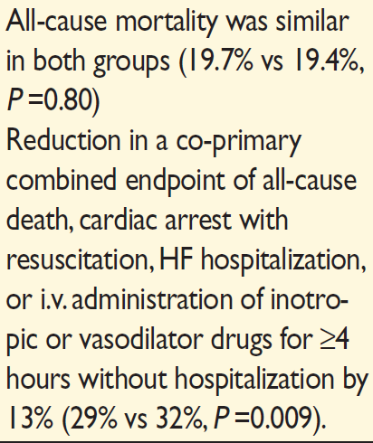
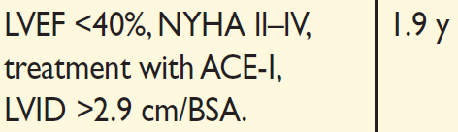

Slide 36
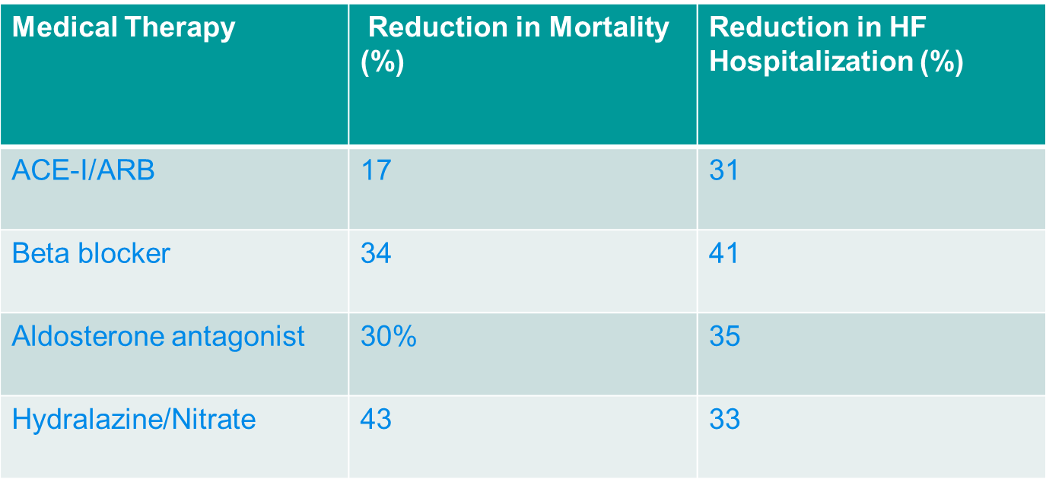
Benefits of Medical Therapy Demonstrated in RCTs
2013 ACC/AHA Guideline for Management of Heart Failure

Slide 37
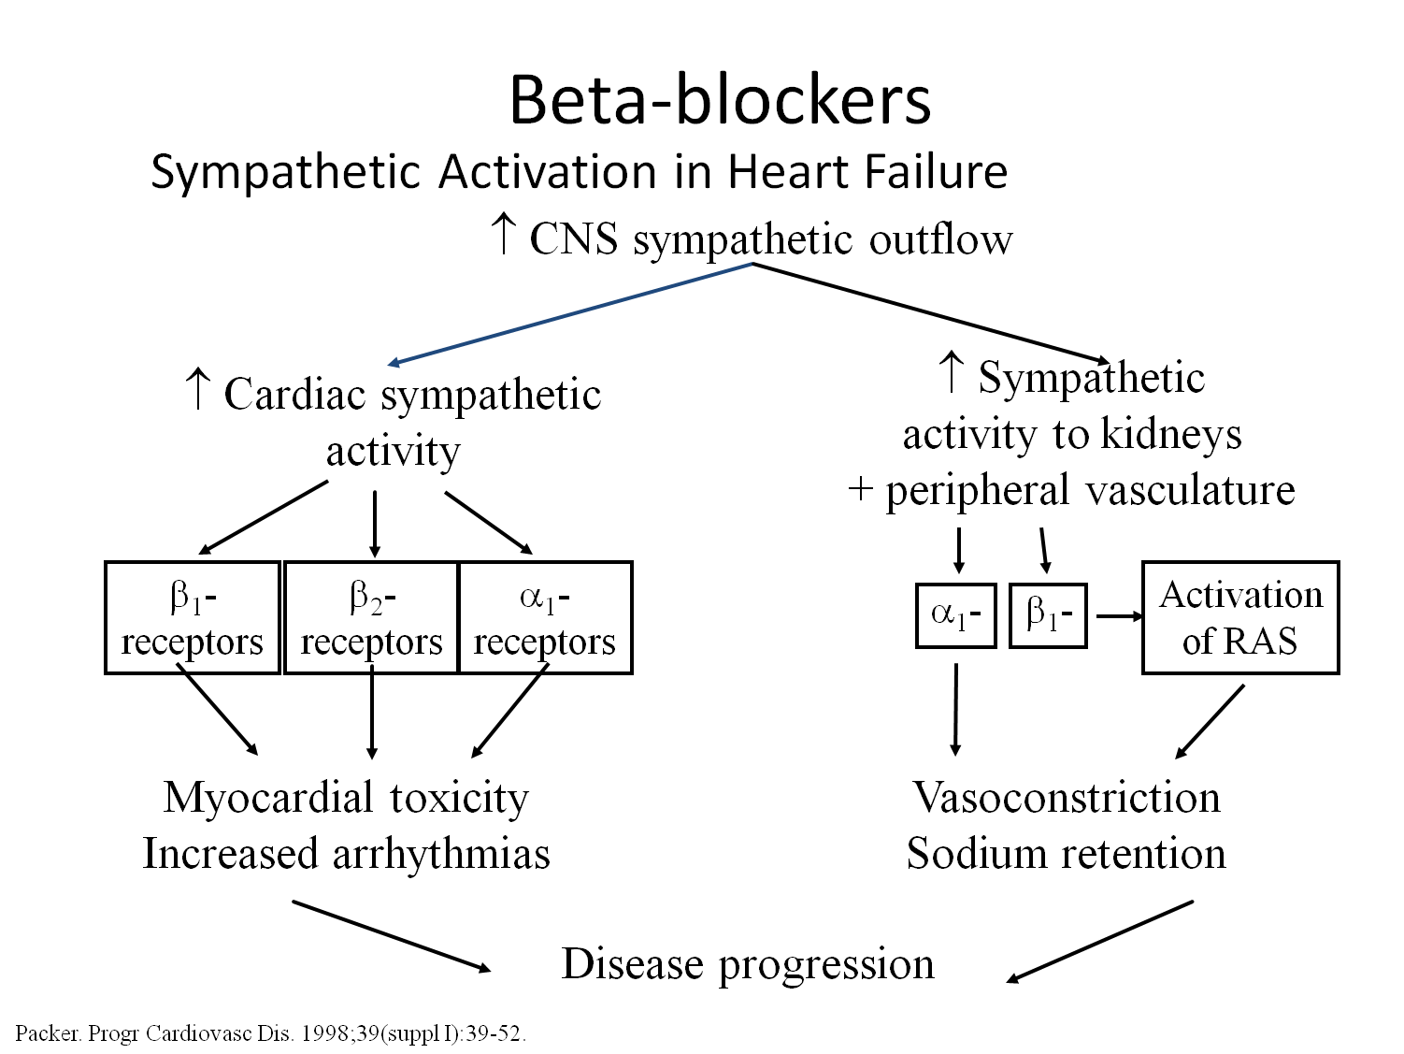

Slide 38
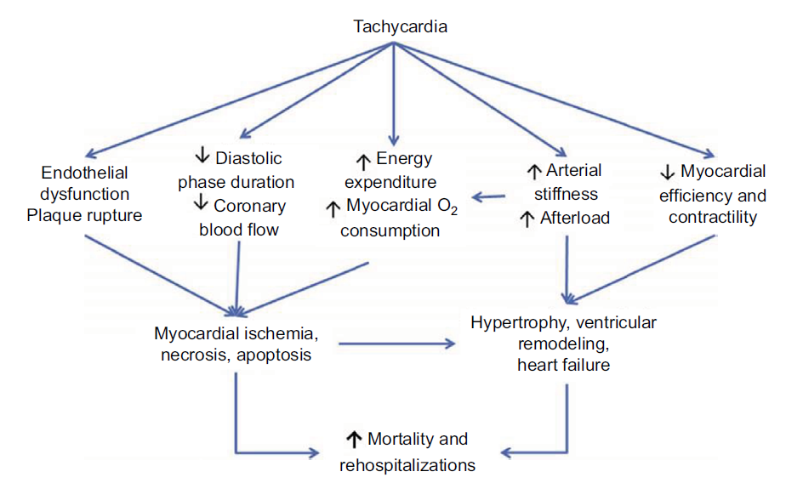

Slide 39
BETA BLOCKERS
WHY?
Indication
improve symptoms
reduce the risk of HF hospitalization
increase survival.
all patients with stable mild or moderate systolic HF (LVEF <40%) (NYHA Class II-III).
First-line treatment, along with an ACE-I and an MRA, in patients with stabilized HF
start as early as possible in the course of disease
Severe HF can start with caution
Contraindications
2 and 3 rd degree av block
Critical limb ischemia
Asthma(RC)

Slide 40
Caution
How to use
NYHA IV HF
Current or recent (<4wk) ADHF
Persisting signs of congestion
Hypotension(<90)
Drug interactions
Verapamil,digoxin,ivabradine, amiodarone
Start with low dose
Double dose not less than 2 wk
Titrate target dose
Monitor HR/BP/signs of congestion

Slide 41
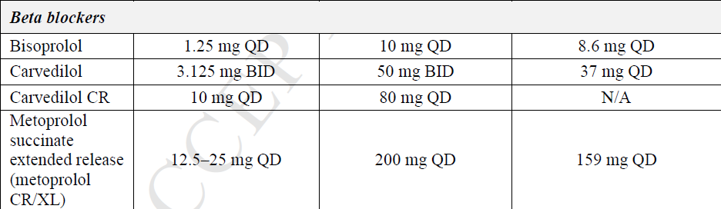
BETA BLOCKERS
ACC
ESC

Slide 42
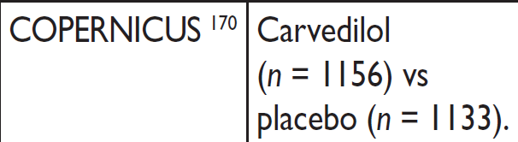
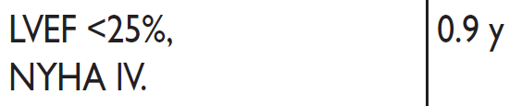
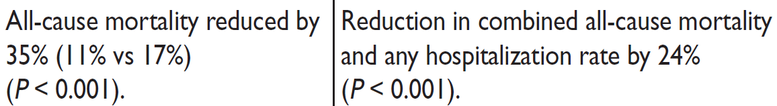

Slide 43
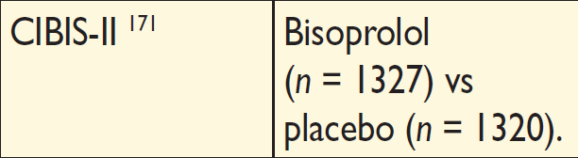
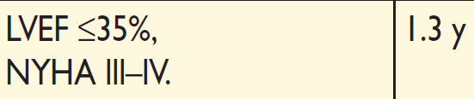
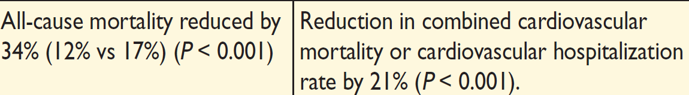

Slide 44
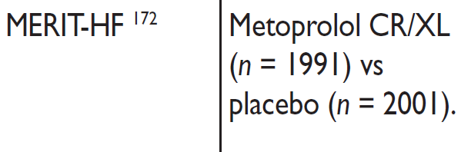
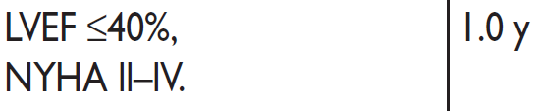
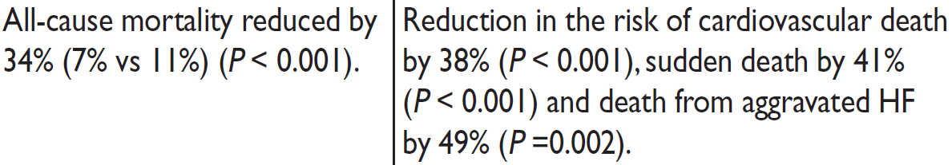

Slide 45
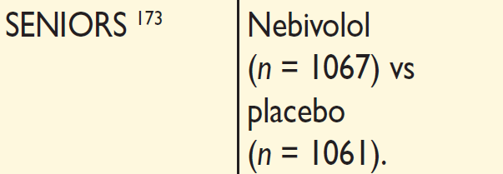
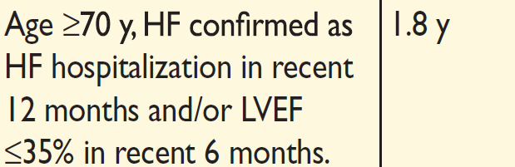
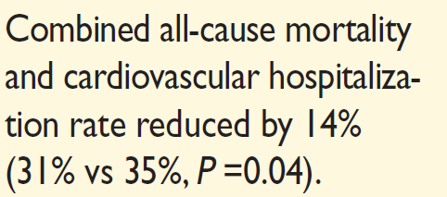

Slide 46


MRA
Indication
WHY?
all patients with persisting symptoms (NYHA Class II–IV) and an LVEF ≤35% despite treatment with an ACE-I (or ARB) and a beta-blocker.
Improve symptoms
reduce the risk of HF hospitalization
increase survival.
ACC
ESC

Slide 47
How to use
Caution
Start with low dose
Dose titration after 4-8wk
Check blood chemistry at 1 and 4 weeks after starting/increasing dose and at 8 and 12 weeks; 6, 9, and 12 months; 4-monthly thereafter
If K+ rises above 5.5 or creatinine rises to 2.5 /eGFR <30 mL—halve dose
If K+ rises to >6.0 or creatinine to >3.5 / eGFR <20 –stop MRA
K+>5
Cr>2.5/GFR<30
Drug interaction
  K+ supplements
  K+-sparing diuretics
  ACE-Is/ARBs/renin inhibitors
  NSAID
  Trimethoprim/trimethoprim-sulfamethoxazole
  Low-salt’ substitutes with a high K+ content.

Slide 48



Slide 49




Slide 50


Hydrolazine and ISDN
Initial dose
Maximum dose

Slide 51
In large scale trials comparing vasodilators vs placebo(Veterans Administration Cooperative Study)
Reduced mortality but not hospitalization when treated with digoxin and diuretics.
Didnot reduce mortality when treated with ACE-I or Beta blockers

Slide 52

DIURETICS

Slide 53


Slide 54


Slide 55
Ivabradine
Why?
Indication
reduce the risk of HF hospitalization and cardiovascular death.
Patients with stable symptomatic HF (NYHA Class II–IV) and an LVEF ≤35% in sinus rhythm and resting heart rate ≥70 bpm despite guidelines-recommended treatment.
Contraindications
Unstable cardiovascular conditions (acute coronary syndrome, stroke/TIA, severe hypotension).
Severe liver dysfunction or renal dysfunction (no evidence on safety or pharmacokinetics for creatinine clearance <15 mL/min).
Pregnancy or breastfeeding

Slide 56


Slide 57
CAUTION
severe (NYHA Class IV) HF.
Current or recent (<4 weeks) exacerbation of
Resting heart rate <50 bpm during treatment.
Moderate liver dysfunction.
Chronic retinal diseases, including RP
Drug interactions:
Bradycardia and induction of long QT
Verapamil, diltiazam
Beta-blocker.
Digoxin.
Amiodarone.
Inhibitors of CYP3A4
Antifungal azoles (such as ketoconazole, itraconazole).
Macrolide antibiotics (such as clarithromycin, erythromycin

Slide 58




Slide 59

DIGOXIN
Block Na-K-ATPase in cardiac cell—increases Ca -- contractility
Sensitize Na-K ATPase activity in vagal afferent nerve –increases vagal tone
Block this enzyme in kidney –decreases sodium resorption
serum level should be <1.0ng/ml

Slide 60
Trials
Two large trials in 1990
Randomised assessment of digoxin and inhibitors of ACE(RADIANCE)
Prospective randomized study of ventricular function and efficacy of digoxin(PROVED)
CONCLUSION
Worsening HF &readmission were more in withdrawn group
But difficult to interpret

Slide 61
Digoxin investigation group(DIG) trial
Prospective study
Conclusion
Neutral effect on mortality
Reduced hospitalization(incl 30d readmission)
Mortality was directly related to serum levels
Post hoc analysis—significant higher(23%) risk of death from all cause in women
All these trials were before widespread use of BB &ACEI.

Slide 62
COMPLICATIONS OF DIGOXIN
Cardiac arrhythmiaa– heart blocks,ectopics,reentant cardiac rhythm
Neuro—visual disturbance, disorientation,confusion
GIT- anorexia, nausea,vomiting
Maintain serum level between 0.5-1ng/ml
Toxicity occur with lower level in hypo K hypo Mg.

Slide 63


Evolution of pharmacologic approaches in HF:
LCZ696 as a new alternative to an ACEI or ARBs in patients with HFrEF¹
SNS
β-blockers
Epinephrine
Norepinephrine
α₁, β₁, β₂
receptors
Neprilysin
inhibitors
Vasoconstriction
RAAS activity
Vasopressin
Heart rate
Contractility
NP system
HF SYMPTOMS & PROGRESSION
NPRs
NPs
Vasodilation
Blood pressure
Sympathetic tone
Natriuresis/diuresis
Vasopressin
Aldosterone
Fibrosis
Hypertrophy
Neprilysin
RAAS
RAAS inhibitors (ACEI, ARB, MRA)
INACTIVE FRAGMENTS
Ang II
AT₁R
Vasoconstriction
Blood pressure
Sympathetic tone
Aldosterone
Hypertrophy
Fibrosis
LCZ696
LCZ696: enhancement of natriuretic and other vasoactive peptides, with simultaneous RAAS suppression

Slide 64


LCZ696 simultaneously inhibits neprilysin (via LBQ657) and blocks AT₁ receptors (via valsartan)
LCZ696
ANP, BNP, CNP, other
vasoactive peptides*
RAAS
Angiotensinogen
(liver secretion)
Neprilysin
Sacubitril
(AHU377; pro-drug)
Ang I
Inactive
fragments
LBQ657
(NEP inhibitor)
Valsartan
Ang II
Enhancing
O
O
AT₁ receptor
Vasorelaxation
 Blood pressure
 Sympathetic tone
 Aldosterone levels
 Fibrosis
 Hypertrophy
 Natriuresis/diuresis
N
OH
Vasoconstriction
 Blood pressure
 Sympathetic tone
 Aldosterone
 Fibrosis
 Hypertrophy
HN
O
Inhibiting
O
OH
N
N
NH
HO
O
N

Slide 65
PARADIGM-HF: Study design
Randomization
n=8442
Double-blind
Treatment period
Single-blind active
run-in period
LCZ696 200 mg BID§
Enalapril
10 mg BID*
LCZ696
100 mg BID‡
LCZ696
200 mg BID§
Enalapril 10 mg BID#
2 Weeks
1–2 Weeks
2–4 Weeks
Median of 27 months’ follow-up
.
On top of standard HFrEF therapy (excluding ACEIs and ARBs)

Slide 66
PARADIGM-HF: Primary objective
To evaluate the effect of LCZ696 200 mg BID compared with enalapril 10 mg BID, in addition to conventional HFrEF treatment, in delaying time to first occurrence of either CV death or HF hospitalization¹
Rationale for endpoint selection
Primary outcome of CV death or HF hospitalization was chosen as the one that
best reflects the major mortality and morbidity burden of HFrEF^{1,2}
  ~80% of deaths in recent trials in patients with HFrEF are CV related³⁻⁵
  HF is associated with a high risk of hospitalization,⁶ representing the leading cause of hospitalization in patients aged ≥65 years⁶⁻⁹
  The most commonly used primary endpoint in recent HF trials:
  CHARM-Added, SHIFT and EMPHASIS-HF¹

Slide 67
Primary outcome
Outcome, n % | LCZ696 (n=4,187) | Enalapril (n=4,212) | Hazard ratio* (95% CI) | p value‡
Primary composite outcome
Death from CV causes or first hospitalization for worsening of HF | 914 (21.8) | 1,117 (26.5) | 0.80 (0.73–0.87) | <0.001
Death from CV causes | 558 (13.3) | 693 (16.5) | 0.80 (0.71–0.89) | <0.001
First hospitalization for worsening of HF | 537 (12.8) | 658 (15.6) | 0.79 (0.71–0.89) | <0.001
The difference in favor of LCZ696 was seen early in the trial and at each interim analysis
Over the duration of the trial, the numbers of patients who would need to have been treated (NNT) to prevent:
  one primary event was 21 patients, and
  one death from CV causes was 32 patients

Slide 68




Slide 69
Newer agents to prevent hyperkalemia during RAAS inhibition
PATIROMER
Non absorbable polymer binds k in exchange for ca in GIT
PEARL-HF study
Used patiromer with spironolactone in 105 HF pt with previous hyperkalemia or CKD
It prevented development of hyperkalemia for more than 4 weeks
OPAL-HK trial
Mean reduction in serum K was 1meq after initial 4 weeks of active treatment
Adverse effect is constipation

Slide 70
ZS-9(zyrconium cyclosilicate)
Highly specific inorganic crystal entraps K in GIT and exchanges Na & H.
HORMONIZE study
RCT long term efficacy and safetyin hyperkalemia pt
Significant reduction in K was observed within 1 hour.
84% achieved normoK @24hr, 98% @48hr.
Dose used in study was 5, 10 15gm

Slide 71
CRT
Simultaneous pacing of both ventricles
Implantation of LV lead involves coronary sinus canulation—placed in lateral or posterior branch
Early CRT—epicardial LV lead with high capture threahold & suboptimal anterior location
Ratinale—intraventricular or interventricular dyssynchrony
LBBB/QRS>120ms is used in trials
50% HF pt N QRS→dyssynchrony
25% pt with EF<35 QRS>150→no dyssynchrony
Acute CRT benift– increse in dp/dt→incre SV
Chronic CRT benifit—reverse remodelling→increse EF

Slide 72


Slide 73
Cardiac Resynchronization:
Proposed Mechanisms
Cardiac Resynchronization
Intraventricular
Synchrony
Atrioventricular
Synchrony
Interventricular
Synchrony
↑ dP/dt, ↑ EF, ↑ CO
(↑ Pulse Pressure)
↓ MR
↓ LA
Pressure
↑ LV Diastolic
Filling
↑ RV Stroke
Volume
↓ LVESV
↓ LVEDV
Reverse Remodeling

Slide 74
MAJOR TRIALS
STUDY(N) | NYHA | QRS | SINUS | ICD
MIRACLE(524) | III,IV | >130 | N | NO
MUSTIC SR(58) | III | >150 | N | NO
MUSTIC AF(43) | III | >200 | AF | NO
PATH CHF(42) | III,IV | >120 | N | NO
CONTAK CD (581) | III-IV | >120 | N | YES
MIRACLE ICD (362) | III-IV | >130 | N | YES
PATH CHF II (89) | III,IV | >120 | N | NO
COMPANION (1520) | III,IV | >120 | N | NO
MIRACLE ICD II (186) | II | >130 | N | YES
CARE HF (813) | III,IV | >12O | N | NO

Slide 75


Slide 76


Slide 78


Slide 79
Complications of CRT
Coronary sinus dissection or perforation(0.4-4%)
Lead dislodgement
Device infection
Pneumothorax
Pocket errosion
Diaphragmatic pacing
Surgical and anesthetic complcations in epicardial lead placeing

Slide 80
COMBINATION OF CRT AND ICD
MIRACLE ICD, CONTAK CD and COMPANION trials showed its not useful.
Should be inserted only if patient needs both.

Slide 81
Indications for CRT Therapy

Slide 82

Mechanical Circulatory Support

Slide 83


Slide 84
Indication
NYHA IV functional class
Life expectancy <2 years
Failure to respond to optimal medical management
LVEF ≤25%
Refractory cardiogenic shock or cardiac failure
VO2 ≤14 mL/kg/min
Need for IV inotropes therapy
Recurrent symptomatic sustained VT or VF in the
presence of an untreatable arrhythmogenic substrate

Slide 85


Slide 86


Slide 87


Slide 88


Slide 89
Types of MCS
Left ventricular assist device (LVAD)
Biventricular support (BiVAD)
Total artificial heart (TAH)

Slide 90




Types of LVADs
First generation pumps
- Pulsatile pumps
Second generation pumps
- Continuous axial flow pumps
Third generation pumps
- Magnetically levitated pump rotor

Slide 91



Commonly Used Durable LVADs
HVAD
Centrifugal LVAD
Magnetic Drive
Hemodynamic Bearing
HeartMate II
Axial Flow LVAD
Ruby Bearing
HeartMate 3
Centrifugal LVAD
Magnetic Levitation
No Bearing

Slide 92
Comparison of Devices
 | First-Generation | Second-Generation | Third-Generation
Flow Profile | Pulsatile | Continuous (Axial) | Continuous (Centrifugal)
Device Example | HeartMate XVE | HeartMate II | HeartMate III, HeartWare HVAD
Device Size | 1150 grams | 290 grams | 160 grams
Recommended Anticoagulation | Aspirin Only | Aspirin + Dipyridamole + warfarin | Aspirin + warfarin
Power Source | Pneumatic or Electric | Electric | Electric
Implant Site | Abdomen | Abdomen/Chest | Pericardium
Approved Indication | BTT, DT | BTT, DT | BTT (HVAD) BTT, DT (HM 3)

Slide 93
Anti-Coagulation Guidelines
Medications
HeartMate II: Aspirin + Dipyridamole or clopidogrel/prasugrel + warfarin
HeartMate 3: Aspirin + warfarin

Slide 94
Complication with LVAD
Infections
Bleeding
Hemolysis
Thrombosis
Stroke
Aortic insufficiency

Slide 95


Total artificial heart (TAH)

Slide 96


Slide 98


Slide 99


Slide 100
Surgical treatment for heart failure
High risk revascularisation
Mitral valve procedure(annuloplasty, coapsy device, MVR
Ventricular restoration
Batista procedure– poor long term effect
Cooley,s procedure—linear closure of aneurysmal segment
Jatene technique
Dor technique
Cardiac support device(myosplint device,CorCap device)

Slide 101


Slide 102


Slide 103

Cardiac support device(myosplint device,CorCap device)

Slide 104



Myosplint device

Slide 105


Slide 106


Slide 107


Slide 108
NEWER MODALITIES

Slide 109



Cardiac contractility modulation

Slide 110



Spinal cord stimulation

Slide 111




Carotid sinus nerve stimulation

Slide 112


Cervical vagal nerve stimulation

Slide 113




Cervical vagal nerve stimulation

Slide 114


Intra cardiac AV nodal stimulation

Slide 115


RV pressure monitoring

Slide 116



LA pressure monitoring(Heart-POD)

Slide 117

Pulmonary artery pressure monitoring
(cardioMEMS)
Monitors PAP
Reduces rate and duration of CHF related hospitalization (CHAMPION study)

Slide 118




Controlled interatrial shunt

Slide 119




Ventricular restoration device

Slide 120
Indication of Ivabradine in EF<35,SR,HR>70
Class I
Class IIa
Class IIb
Class III

Slide 121
Indication of Ivabradine in EF<35,SR,HR>70
Class I
Class IIa
Class IIb
Class III

Slide 122
Which of the following is false regarding target dose
Metoprolol succinate(XL)---200mg OD
Metoprolol succinate(XL)---100mg BD
Spironolactone 50 mg OD
Spironolactone 25mg BD
Enalapril 20mg BD

Slide 123
Which of the following is false regarding target dose
Metoprolol succinate(XL)---200mg OD
Metoprolol succinate(XL)---100mg BD
Spironolactone 50 mg OD
Spironolactone 25mg BD
Enalapril 20mg BD

Slide 124
Initial dose and target dose of Hydralazine and ISDN(37.5mg+20mg)
Half tablet TDS and one tablet TDS
One tablet TDS and 2tablet TDS
Half tablet BD and one tablet BD
One tablet BD and 2 ttablet BD

Slide 125
Initial dose and target dose of Hydralazine and ISDN(37.5mg+20mg)
Half tablet TDS and one tablet TDS
One tablet TDS and 2tablet TDS
Half tablet BD and one tablet BD
One tablet BD and 2 ttablet BD

Slide 126
ARB not recommended in HF
Candesartan
Losartan
Valsartan
Telmisartan

Slide 127
ARB not recommended in HF
Candesartan
Losartan
Valsartan
Telmisartan

Slide 128
Match the following
TRIAL | DRUG
SOLVED TREATMENT | BISOPROLOL
CIBIS-II | CANDESARTAN
SENIORS | LISINOPRIL
CHARM HF | ENALAPRIL
ATLAS | NEBVOLOI

Slide 129
Match the following
TRIAL | DRUG
SOLVED TREATMENT | ENALAPRIL
CIBIS-II | BISOPROLOL
SENIORS | NEBVOLOL
CHARM HF | CANDESARTAN
ATLAS | LISINOPRIL

Slide 130
Thank you

